Slide 1
THE ENTITY- RELATIONSHIP (ER) MODEL

Slide 2
STEPS IN DATABASE DESIGN
Requirements collection and analysis
DB designers interview prospective DB users to understand and document data requirements
Data requirements
Functional requirements of the principal applications
Conceptual or logical DB design
Description of data requirements
Detailed descriptions of components and constraints
Transformed into implementation data model
Result: DB schema in implementation data model of DBMS
Physical DB design
Internal storage structures, file organizations, indexes, access paths, and physical design parameters for the DB files
External or view design

Slide 3
A SAMPLE DATABASE APPLICATION
Requirements gathered for COMPANY
Employees, departments, and projects
Company is organized into departments
Department controls several projects
Employee: require each employee’s name, Social Security number, address, salary, sex (gender), and birth date
Keep track of the dependents of each employee

Slide 4
ER MODEL OVERVIEW
ER model describes data in terms of:
Entities and entity sets
Objects
Relationships and relationship sets
Connections between objects
Attributes
Properties that characterize or describe entities or relationships

Slide 5
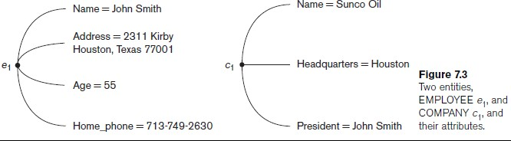
ENTITIES AND ATTRIBUTES EXAMPLE

Slide 6
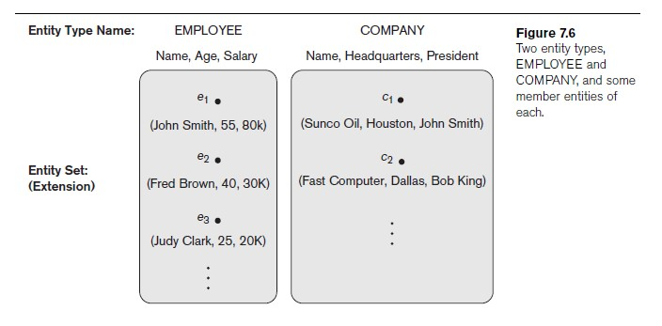
ENTITY SETS
Entity type or set
Collection (or set) of similar entities that have the same attributes
ER model defines entity sets, not individual entities
But entity sets described in terms of their attributes

Slide 7
CATEGORIES OF ATTRIBUTES
Simple (atomic) vs. composite attributes
Single-valued vs. multivalued attributes
Stored vs. derived attributes
Key or unique attributes
Attribute values constrained to be distinct for individual entities in entity set

Slide 8
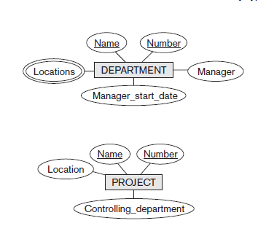
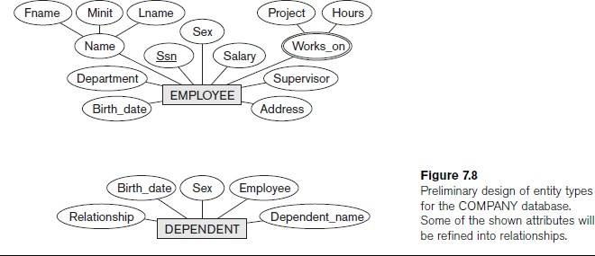
INITIAL ER DIAGRAM FOR COMPANY
Four entity types
Most attributes are simple, single-valued, and stored
Works_on and Locations are multivalued
Employee’s Name is composite
Employee has one key, department and project have two keys, dependent has none

Slide 9
WEAK ENTITY TYPES
Entity types that do not have key attributes of their own
Identified by their relationship to specific entities from another entity
type
Dependent is meaningless in COMPANY DB independently of Employee
Identified by relationship to Employee
Dependent_name distinguishes one dependent from other dependents for the same employee: partial key
Identifying relationship
Relates a weak entity type to the identifying entity, which has the rest of the key

Slide 10
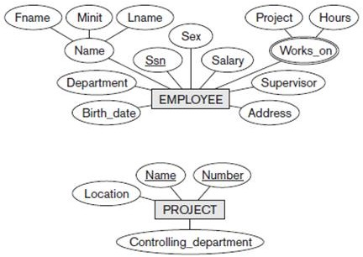
RELATIONSHIPS IN GENERAL
Relationship
Interaction between entities
Indicator: an attribute of one entity refers to another entity
Represent such references as relationships not attributes

Slide 11
RELATIONSHIPS
Relationship
Interaction between entities
Indicator: an attribute of one entity refers to another entity
Represent such references as relationships not attributes
Relationship type R among n entity types E₁, E₂, ..., E_{n}
Defines a set of associations among entities from these entity types
Relationship instance r_{i}
Each r_{i} associates n individual entities (e₁, e₂, ..., e_{n})
Each entity e_{j} in r_{i} is a member of entity set E_{j}
Relationships uniquely identified by keys of participating entities
Degree of a relationship type
Number of participating entity types
e.g., binary, ternary

Slide 12
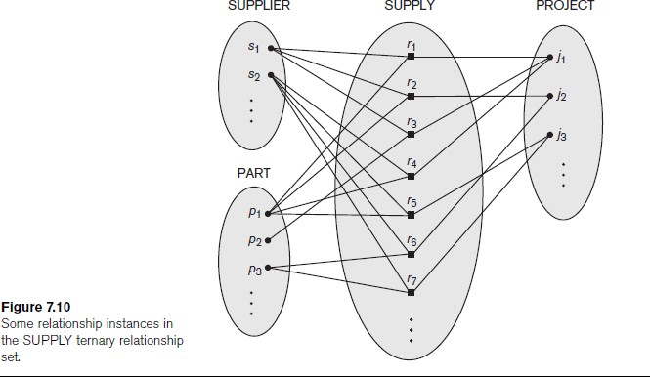
RELATIONSHIPS & RELATIONSHIP SETS

Slide 13
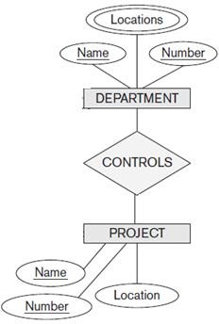
DIAGRAMMING RELATIONSHIP TYPE
Diamond for relationship type
Connected to each participating entity type
Could be binary, ternary, or higher degree
Remember:
Represents a set of entities of each type, some of which are related to entities of the other type(s)
Some entities might participate in several relationships
Some entities might not participate in the relationship at all

Slide 14
RELATIONSHIPS WITH REPEATED ENTITY SETS
Some relationships involve multiple entities from the same entity set
e.g., spouse (two persons), games (two teams)
e.g., recursive relationships, such as supervises (two employees)
Role name
Signifies role that participating entity plays in relationship instance
Required when entity type participates multiple times in a relationship

Slide 15
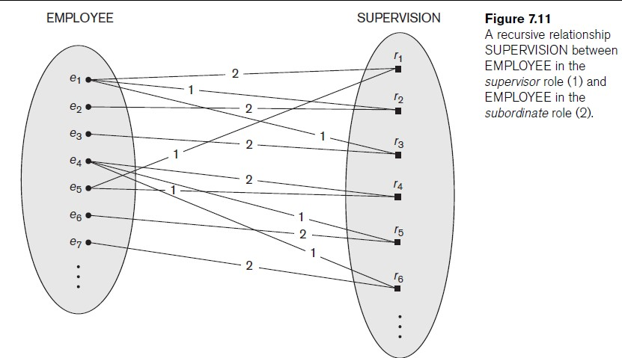
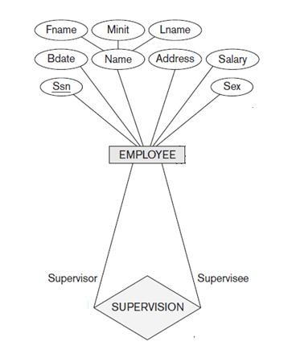
USING ROLE NAMES

Slide 16
RELATIONSHIP CONSTRAINTS
Cardinality ratio
Specifies maximum number of relationship instances in which each entity can participate
Types 1:1, 1:N, or M:N
Participation constraint
Specifies whether existence of entity depends on its being related to another entity
Types: total and partial
Thus minimum number of relationship instances in which entities can participate: thus1 for total participation, 0 for partial
Diagrammatically, use a double line from relationship type to entity
type

Slide 17
RELATIONSHIP ATTRIBUTES
Relationship types can also have attributes
Property that depends on both/all participating entities
Example: Percentage of control that department has on a project
CONTROLS
Percent
Attributes of 1:1 or 1:N relationship types can be migrated to one of the participating entity types
For a 1:N relationship type, relationship attribute can be migrated only to entity type on N-side of relationship
Attributes on M:N relationship types must be specified as relationship attributes

Slide 18
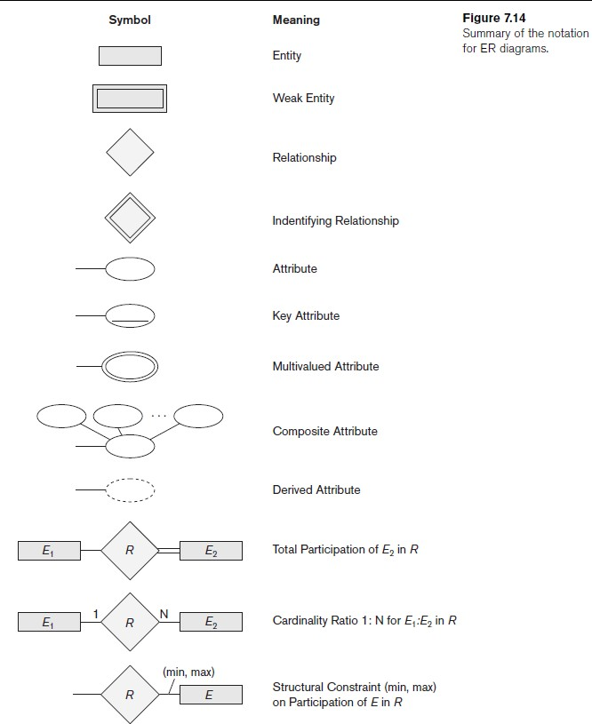
SUMMARY OF ER DIAGRAM SYMBOLS
⟹ 1 E₁ entity can be related to N E₂ entities

Slide 19
REFINING EXAMPLE ER DESIGN
Recall preliminary ER design
Change attributes that reference entity types into relationship types
Weak entities use identifying relationship
Determine cardinality ratio and participation constraints for each relationship type
Weak entity type always has structural constraint of (1,1) participation in identifying relationship

Slide 20
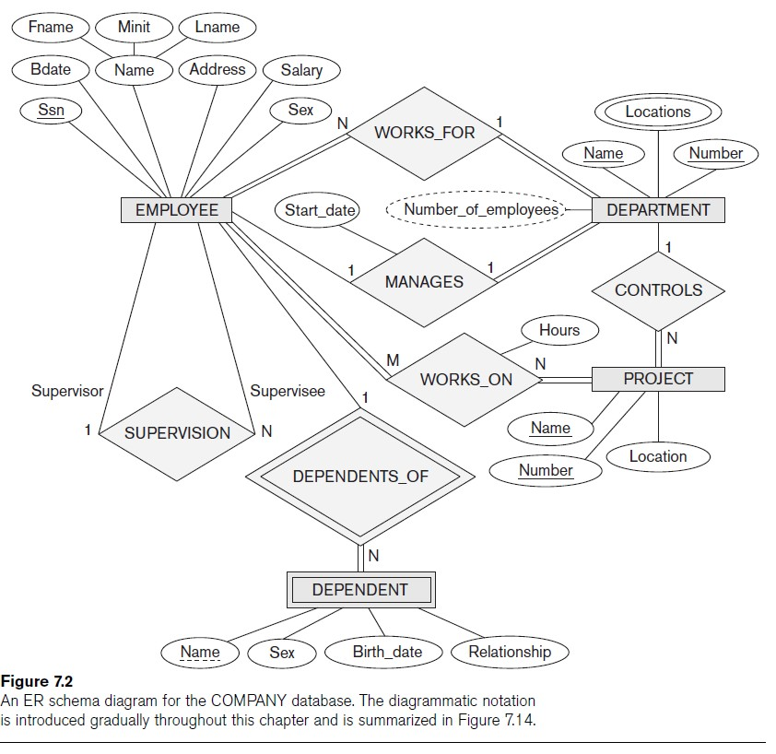

Slide 21
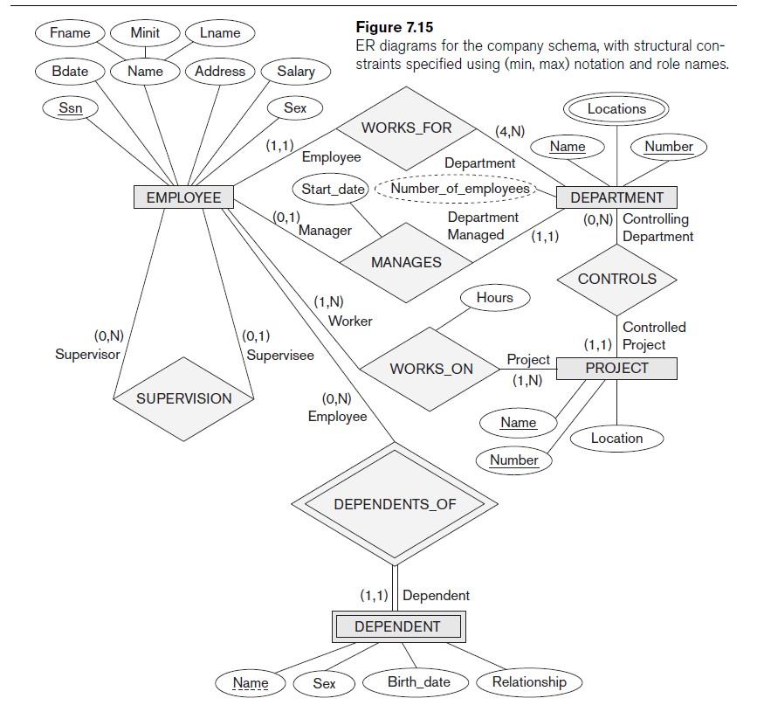

Slide 22
APPROPRIATE ER MODEL DESIGN
Choose names that convey meanings attached to various constructs.
Nouns give rise to entity type names
Verbs indicate names of relationship types
Choose binary relationship names to make ER diagram readable from left to right and from top to bottom
Review all attributes
Refine into a relationship if attribute references an entity type
Attribute that exists in several entity types may be better modelled
as an independent entity type
Entities that must participate in a relationship with another entity type and with cardinality constraint of 1 might be better modelled as weak entity

Slide 23
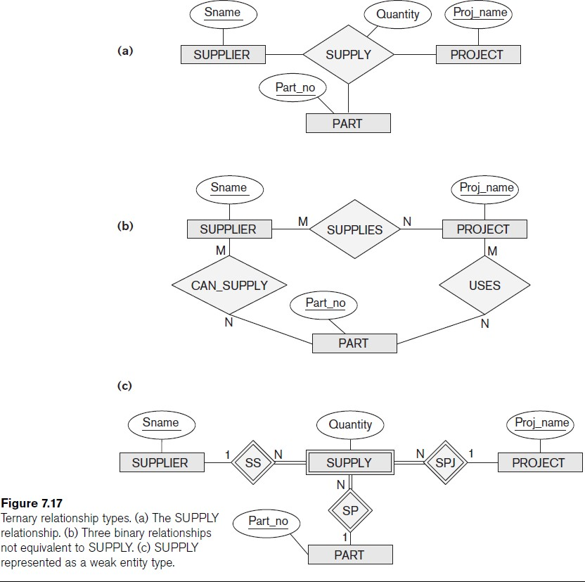
REVIEW HIGH-DEGREE RELATIONSHIPS

